Slide 1
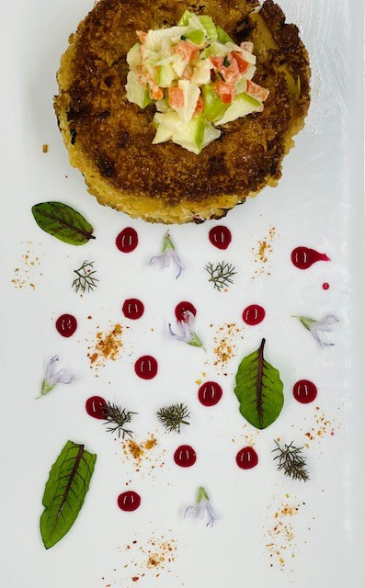
CULINARY
Chef Dave Hatfield
Chef Moon-Ku Jun
Chef Holly Odegard
Program Name
Goes Here
Presenter Name Goes Here
Notes:
Welcome, introduce yourself and the program. Feel free to share about your education/career background, how long you’ve been teaching, etc.

Slide 2
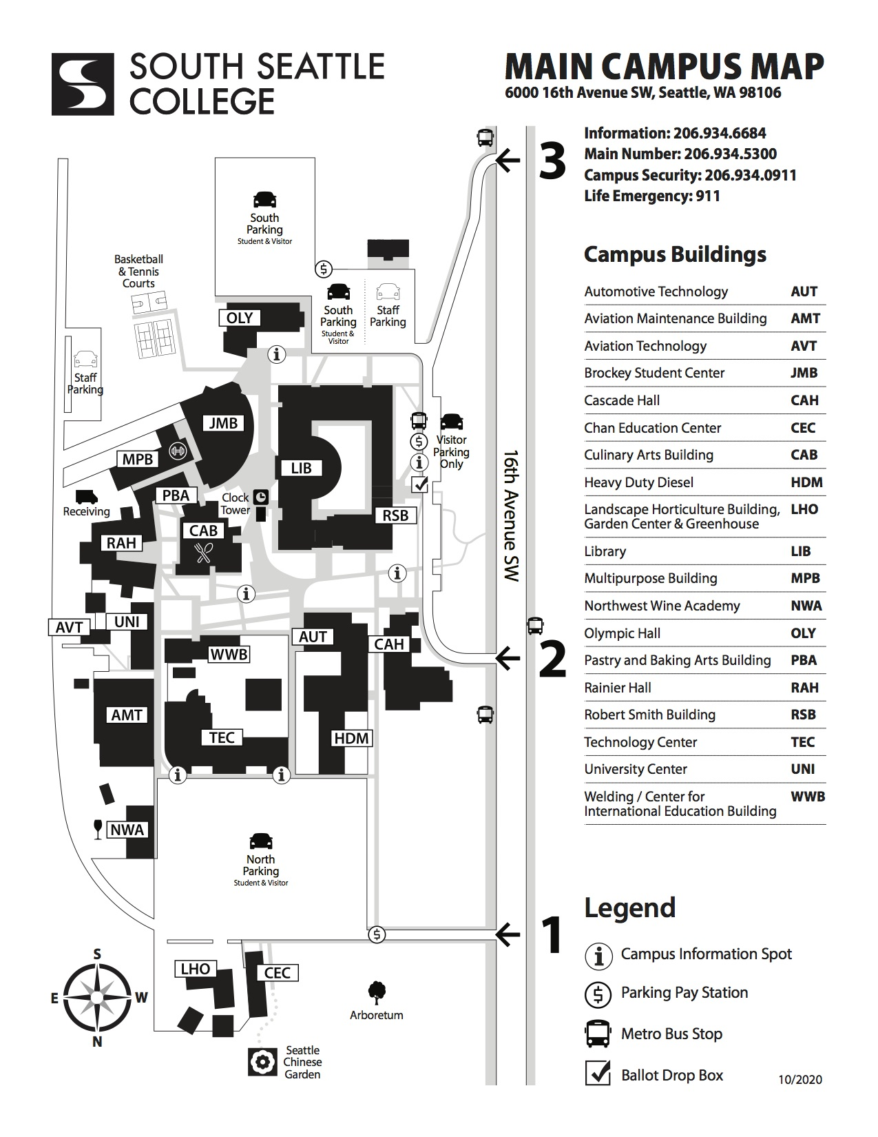
What is the program?
Our program schedule……
The culinary program meets on campus on Monday through Thursday. Every Friday is Zoom lecture. While in the kitchen at school student learn a variety of techniques and recipes and then are able to practice those skills. The entire program spans five 11-week quarters.
Required supplies
Uniform, Knives, Text Books

Slide 3
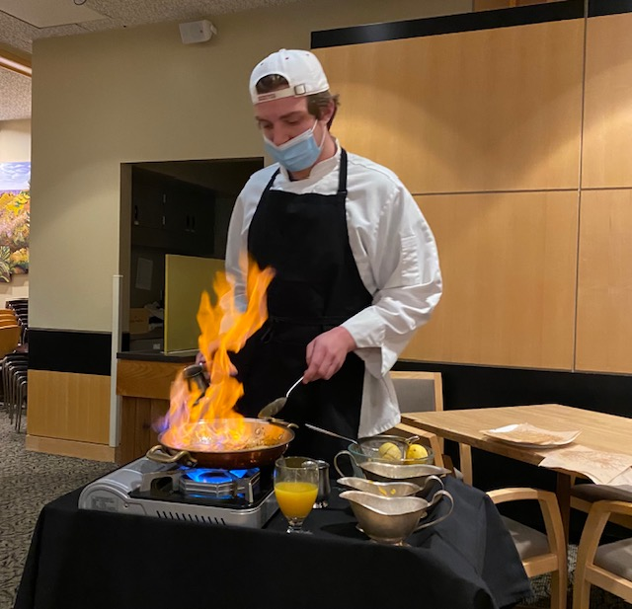
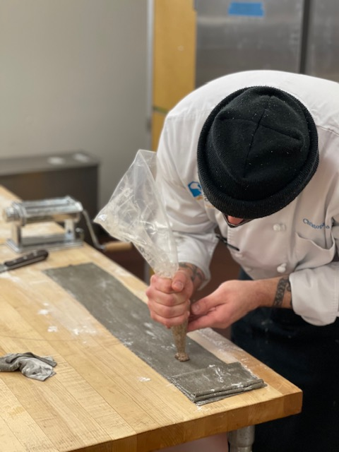
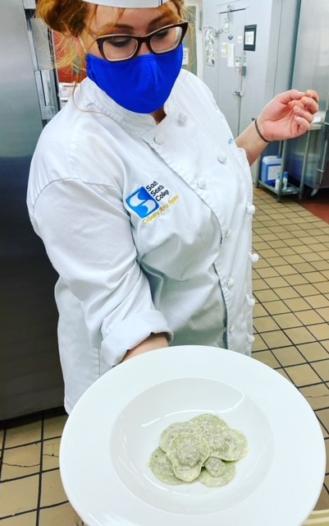
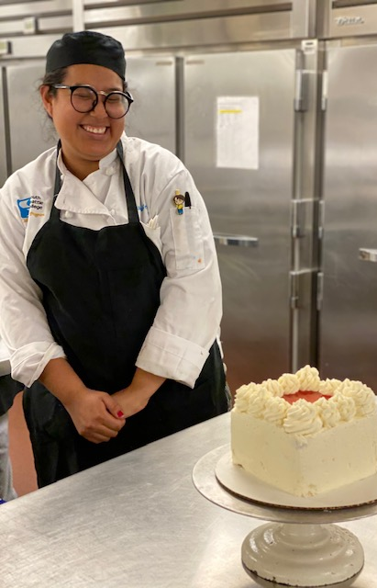
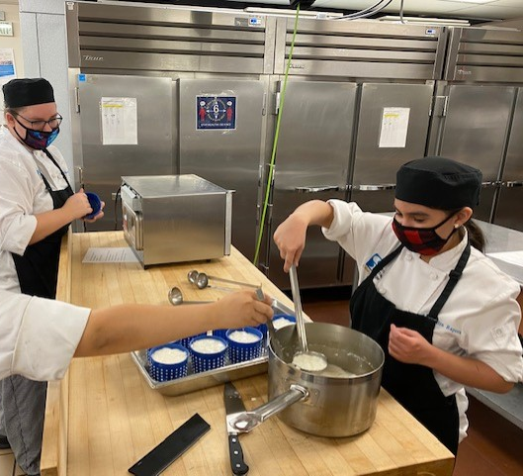
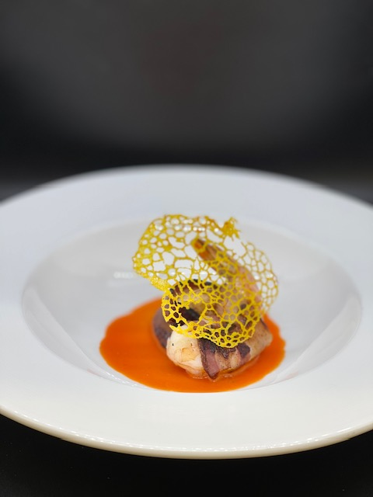
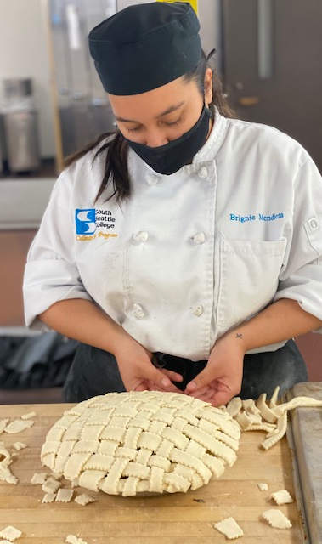
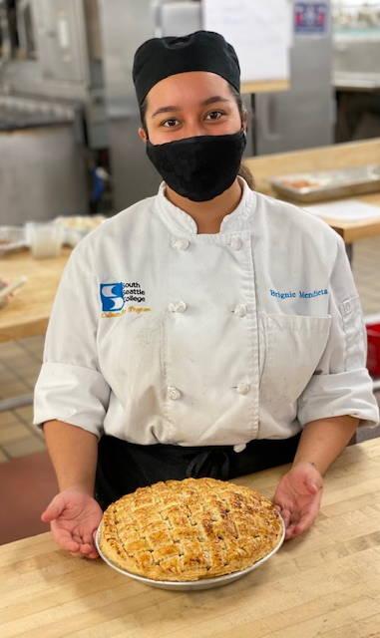
A Typical Day at School
Everyone’s favorite day! The flambee throw-down
Pasta making
Cake anyone?
Fancy food pics
Cheese making
PIE!!

Slide 4
What do you learn?
Management skills
knife skills
Farm to Table
VEGETABLES
meats
Classic cooking techniques
desserts
Flavor profiles
Business ownership
pasta
Bread
seafood
INTERNATIONAL CUISINE

Slide 5
Education Pathway
FSD 165
Basic Culinary Skills
FSD 175
Sauces, Soups, Starches and Meats
FSD 185
Appetizers, International cuisines, pastry
FSD 195
FSD 205
Advanced Techniques, Breads
Management skills, Wine
Restaurant Production Certificate
66 credits
Associate of Applied Science Degree (AAS)
101 credits

Slide 6
Careers/Jobs
Cook (average $20/hr)
Sous Chef (average $35-40k/year
Chef (average $60k/year
Business owner
Teacher
Food writer/ photographer
Wine industry
Nutritional services
Institutional services (schools, nursing homes)
Hotel, Resort and Cruise Lines
Commercial food production

Slide 7
Q & A
Who are the Chef Instructors: Chef Jun, Chef Dave and Chef Holly
Is financial aid available for tuition and supplies: yes
Can I work a job and attend school: Yes, many students work jobs outside of school
What are the hours of class: M-Thur 8am-1pm, Friday 8-noon
Do I have to take summer classes: No, normal culinary classes run fall through spring
Is there scholarship money available:many scholarship opportunities exist
Will I be able to find a job after graduation: Job opportunities are plentiful
Chef Dave Hatfield
David.hatfield@seattlecolleges.edu
(541) 390-3783

Slide 8
Return to Main Session
(select “Leave Breakout Room” to return)

